Slide 1
Project Report Template
An Index of Economic Freedom Analysis
Dr.Nallikuppusamy Arts College
Thanjavur
FACULITY MENTOR:Ms.M.R.Atchayapriya Msc,Mphil.,
Project done by
B.KALAIVANI-Team leader
M.NARMATHA-Team member
M.SNEHA-Team member
S.YOGESHWARI-Team member

Slide 2
INTRODUCTION
AN INDEX OF ECONOMIC FREEDOM ANALYSIS
Economic freedom is the fundamental right of every human to control his or her own labor and property.In an economically free society,individuals are free to work,produce,consume,and invest in any way they please.In economically free societies,geverments allow labor,capital,and goods to move freely,and refrain from coercion or constraint of liberty beyond the extent necessary to protect and maintain liberty itself.
For much of human history, most individuals have laced economic freedom and opportunity,condemning them to poverty and deprivation.
Today,we live in the most prosperous time in human history.Poverty,sicnesses,and ignorance are receding throughout the world,due in large part to the advance of economic freedom. In 2022,the principles of economic freedom that have fueled this monumental progress are once again measured in the Index of Economic Freedom,an annual guide published by The Heritage Foundation,Washington’s No.1 thing tank.

Slide 3
PURPOSE
An Index of economic freedom measures jurisdiction against each other in terms of parameters such as trade freedom, tax burden, judicial effectiveness, and more. These factors may be weighted according to their influence on economic freedom and compiled into a single score that allows for a ranking.

Slide 4

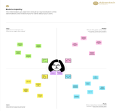
Template
✴
Build empathy
The information you add here should be representative of the observations and research you've done about your users.
Empathy map
Use this framework to develop a deep, shared understanding and empathy for other people. An empathy map helps describe the aspects of a user's experience, needs and pain points, to quickly understand your users’ experience and mindset.
Says
What have we heard them say? What can we magine them saying?
Thinks
What are their wants, needs, hopes, and dreams? What other thoughts might influence their behavior?
The main aim of development is to update as per the demand of time.
What is the main idea of economic freedom?
What are the criteria for the freedom Index?
Developmental goals are necessary to get a better income and other things in life.
What is the economic freedom Index of India?
It causes destruction for famers and the lives of people living nearby.
Give them a name and a portrait to empathize with your persona.
Economic freedom is an indispensable means toward the achievement of political freedom.
The lack of economic freedom could be a very major reason for loss of liberty, liberty of life.
business development
Until economic freedom is attained for everybody, there can be no real freedom for anybody.
Improve economic development
Developing Jobs
Does
What behavior have we observed? What can we imagine them doing?
Feels
What are their fears, frustrations, and anxieties? What other feelings might
influence their behavior?
Share template feedback
Need some inspiration?
See a finished version of this template to kickstart your work.
Open example

Slide 5
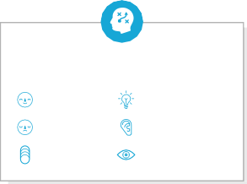







Template
Before you collaborate
A little bit of preparation goes a long way with this session. Here’s what you need to do to get going.
10 minutes
1
Define your problem statement
What problem are you trying to solve? Frame your problem as a How Might We statement. This will be the focus of your brainstorm.
2
Brainstorm
Write down any ideas that come to mind that address your problem statement.
3
Group ideas
Take turns sharing your ideas while clustering similar or related notes as you go. Once all sticky notes have been grouped, give each cluster a sentence-like label. If a cluster is bigger than six sticky notes, try and see if you and break it up into smaller sub-groups.
4
Prioritize
Your team should all be on the same page about what's important moving forward. Place your ideas on this grid to determine which ideas are important and which are feasible.
After you collaborate
You can export the mural as an image or pdf to share with members of your company who might find it helpful.
TIP
You can select a sticky note and hit the pencil [switch to sketch] icon to start drawing!
5 minutes
10 minutes
20 minutes
20 minutes
Brainstorm
& idea prioritization
Use this template in your own brainstorming sessions so your team can unleash their imagination and start shaping concepts even if you're not sitting in the same room.
An index of economic freedom compares the jurisdictions against each other for various aspects, such as trade freedom, judicial effectiveness, and tax burden.
_{A} Team gathering
Define who should participate in the session and send an invite. Share relevant information or pre-work ahead.
Person 1
Plans, designs, and delivers
Person 2
Local Indigenous and non-
Person 3
Person 4
Leading projects to
Plans,designs,and delivers economic development strategies.
TIP
Add customizable tags to sticky notes to make it easier to find, browse, organize, and categorize important ideas as themes within your mural.
Plans,designs,and delivers economic development strategies.
Quick add-ons
Acts as an important connection
Community colleges, universities
Technology ^{Not-for-profits}
Leading
A
Share the mural
Share a view link to the mural with stakeholders to keep them in the loop about the outcomes of the session.
or business
&
enhance
economic
^{economic} between public and
development
Indigenous and research
humanitarian
_{economic} development
_{B} Set the goal
Think about the problem you'll be focusing on solving in the brainstorming session.
strategies.
private sectors and the community.
governments. institutions.
^{incubators.} organizations.
development. ^{planning.}
B
Export the mural
Export a copy of the mural as a PNG or PDF to attach to emails, include in slides, or save in your drive.
_{C} Learn how to use the facilitation tools
Use the Facilitation Superpowers to run a happy and productive session.
Plans, designs, and delivers economic development strategies.
10 minutes to prepare
1 hour to collaborate
2-8 people recommended
Open article
Keep moving forward
Person 5
Person 6
Person 7
Person 8
Strategy blueprint
Define the components of a new idea or strategy.
Open the template
Key rules of brainstorming
To run an smooth and productive session
Acts as an important connection between public and private sectors and the community.
Community colleges, universities and research institutions.
Local Indigenous and non- Indigenous governments.
Customer experience journey map
Understand customer needs, motivations, and obstacles for an experience.
Open the template
Stay in topic.
Encourage wild ideas.
Importance
If each of these tasks could get done without any difficulty or cost, which would have the most positive impact?
Technology or business incubators.
Defer judgment.
Listen to others.
Leading economic development planning.
Leading projects to enhance economic development.
Go for volume.
If possible, be visual.
Strengths, weaknesses, opportunities & threats
Identify strengths, weaknesses, opportunities, and threats (SWOT) to develop a plan.
Open the template
Not-for-profits & humanitarian organizations.
TIP
Participants can use their cursors to point at where sticky notes should go on the grid. The facilitator can confirm the spot by using the laser pointer holding the H key on the keyboard.
Share template feedback
Share template feedback
Feasibility
Regardless of their importance, which tasks are more feasible than others? (Cost, time, effort, complexity, etc.)
Need some inspiration?
See a finished version of this template to kickstart your work.
Open example

Slide 6
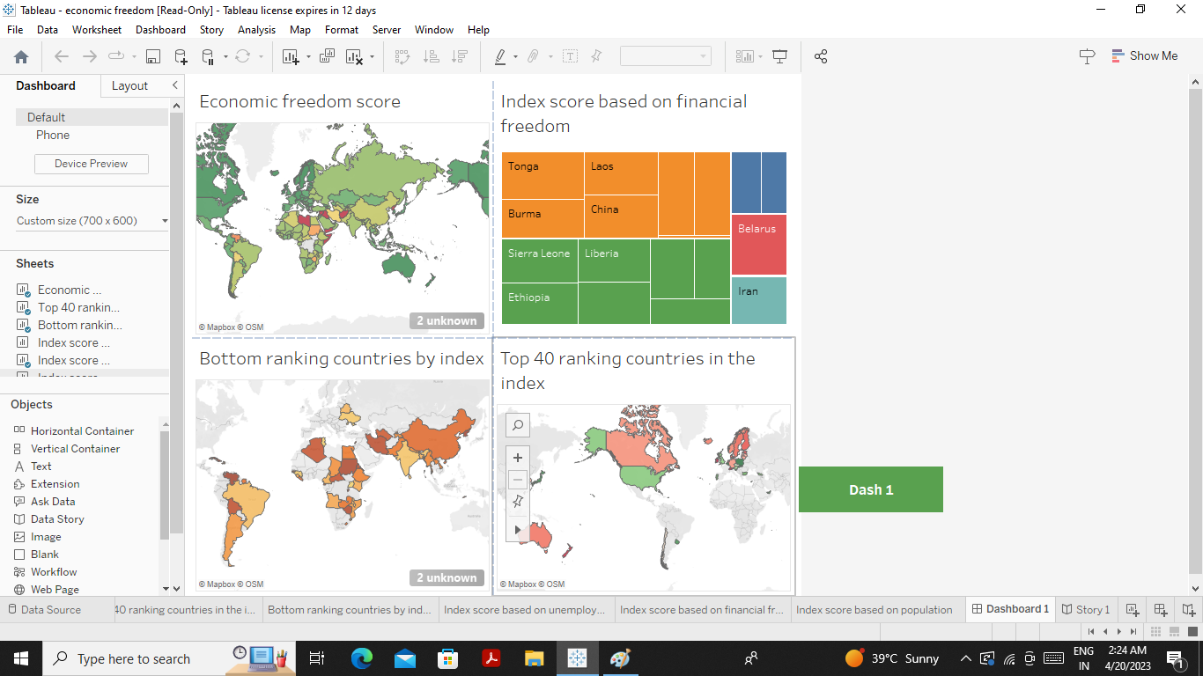

Slide 7
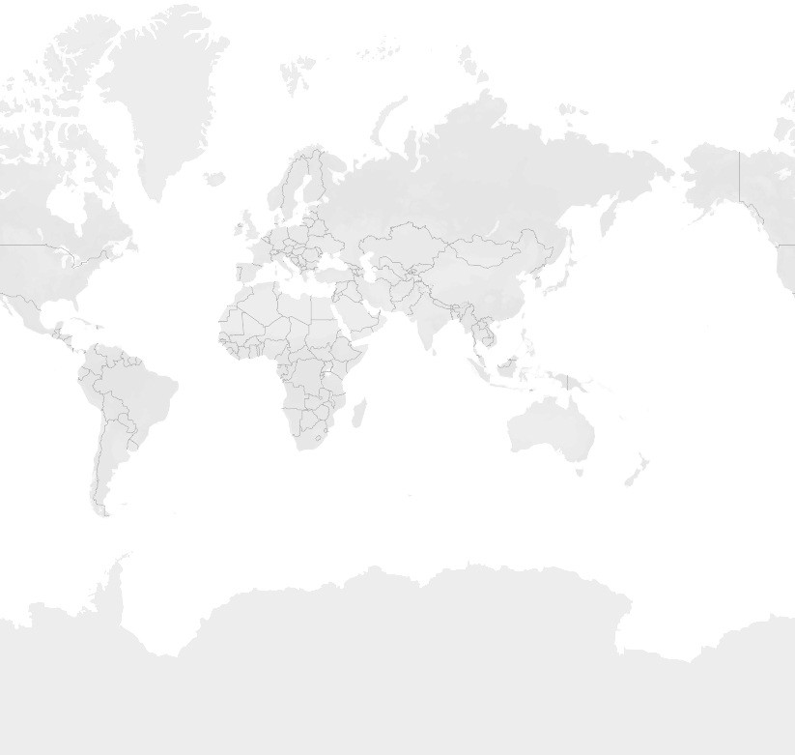

















Story 1
Economic freedom score
Top 40 ranking countries in the index | Bottom ranking countries by index | Index score based on unemployment rate | Index score based on ﬁnancial freedom | Index score based on population
2022 Score
0.00
84.40
© 2023 Mapbox © OpenStreetMap

Slide 8
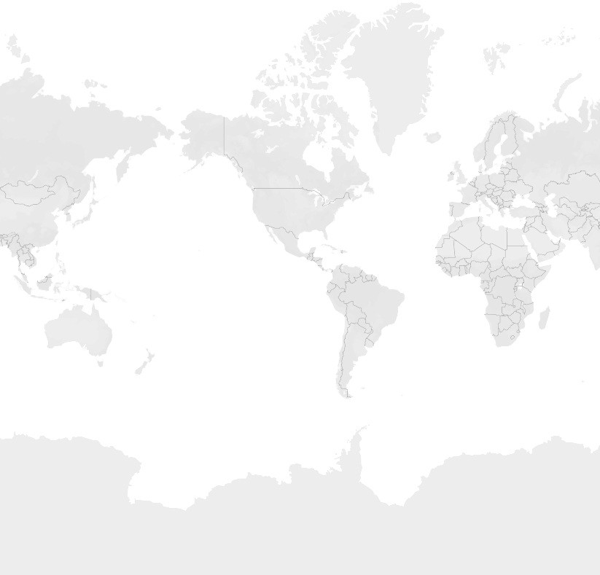
Story 1
Economic freedom score
Top 40 ranking countries in the index | Bottom ranking countries by index | Index score based on unemployment rate | Index score based on ﬁnancial freedom | Index score based on population
World Rank
1
40
© 2023 Mapbox © OpenStreetMap

Slide 9
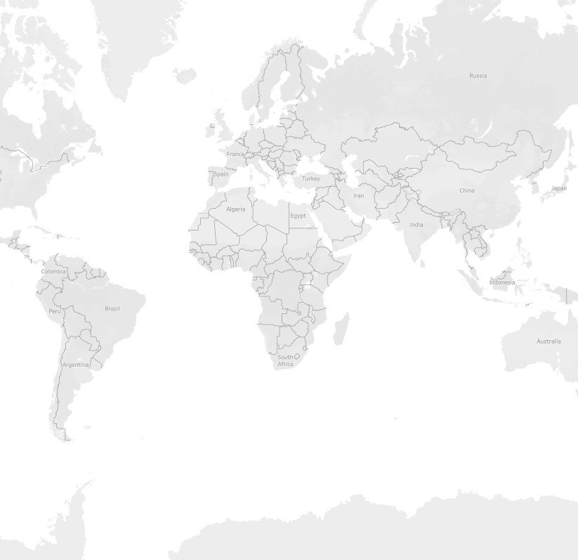




Story 1
Economic freedom score
Top 40 ranking countries in the index
Bottom ranking countries by index | Index score based on unemployment rate | Index score based on ﬁnancial freedom | Index score based on population
World Rank
127
177
© 2023 Mapbox © OpenStreetMap

Slide 10
Story 1
Economic freedom score
Top 40 ranking countries in the index
Bottom ranking countries by index
Index score based on unemployment rate | Index score based on ﬁnancial freedom | Index score based on population
Country Name
30
Measure Names Inﬂation (%) Unemployment (%)
2400
2200
25
2000
1800
1600
1400
20
Inﬂation (%)
Unemployment (%)
1200
15
1000
800
10
600
400
5
200
0
0
Afghanistan
Albania Algeria Angola Argentina Armenia Australia Austria Azerbaijan Bahamas Bahrain Bangladesh Barbados Belarus Belgium Belize Benin Bhutan Bolivia
Bosnia and Herzegovina
Botswana
Brazil Brunei Darussalam
Bulgaria Burkina Faso
Burma Burundi Cabo Verde Cambodia Cameroon Canada
Central African Republic
Chad Chile China

Slide 11
Story 1
Economic freedom score | Top 40 ranking countries in the index | Bottom ranking countries by index | Index score based on unemployment rate | Index score based on ﬁnancial freedom | Index score based on population
Tonga
Laos
Timor-Leste
Turkmenistan
Cuba
Region
Americas Asia-Paciﬁc Europe
Middle East and Nort.. Sub-Saharan Africa
Burma
China
Belarus
Sierra Leone
Liberia
Eritrea
Zimbabwe
Ethiopia
Congo Democratic Republic of the Congo
Iran
Sudan

Slide 12
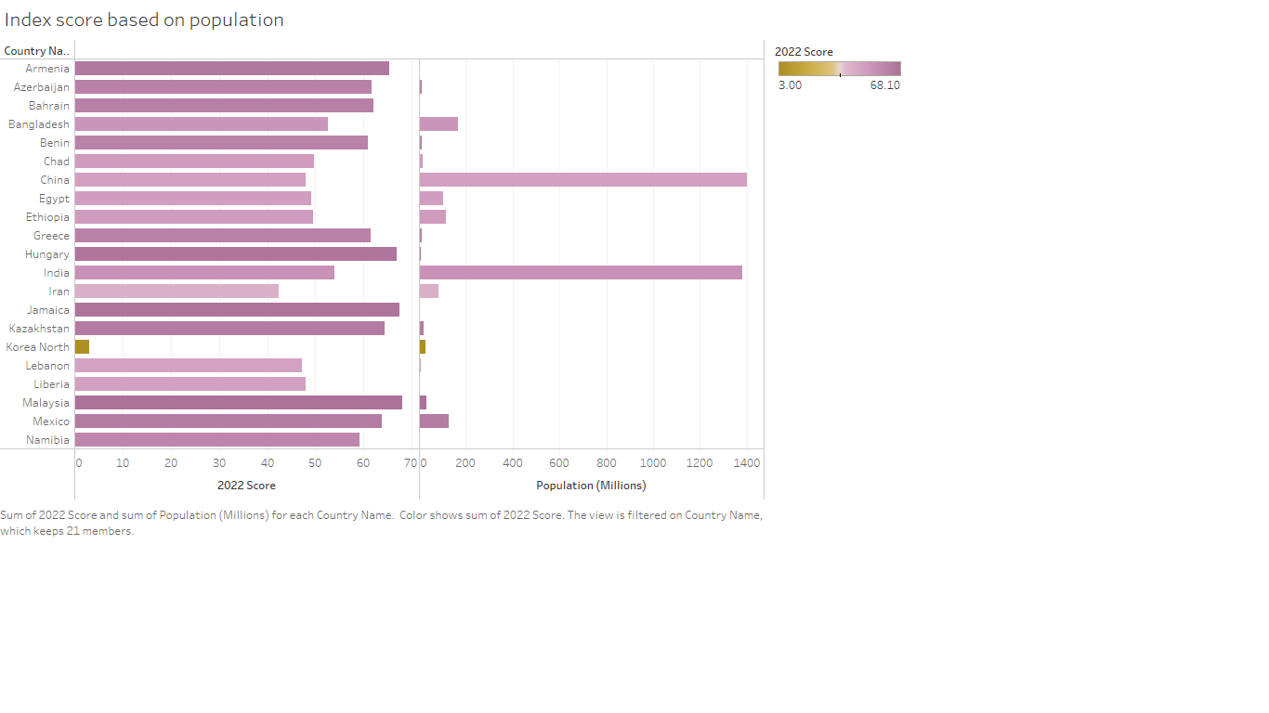

Slide 13
Template
Before you collaborate
A little bit of preparation goes a long way with this session. Here’s what you need to do to get going.
10 minutes
1
Define your problem statement
What problem are you trying to solve? Frame your problem as a How Might We statement. This will be the focus of your brainstorm.
2
Brainstorm
Write down any ideas that come to mind that address your problem statement.
3
Group ideas
Take turns sharing your ideas while clustering similar or related notes as you go. Once all sticky notes have been grouped, give each cluster a sentence-like label. If a cluster is bigger than six sticky notes, try and see if you and break it up into smaller sub-groups.
4
Prioritize
Your team should all be on the same page about what's important moving forward. Place your ideas on this grid to determine which ideas are important and which are feasible.
After you collaborate
You can export the mural as an image or pdf to share with members of your company who might find it helpful.
TIP
You can select a sticky note and hit the pencil [switch to sketch] icon to start drawing!
5 minutes
10 minutes
20 minutes
20 minutes
Brainstorm
& idea prioritization
Use this template in your own brainstorming sessions so your team can unleash their imagination and start shaping concepts even if you're not sitting in the same room.
An index of economic freedom compares the jurisdictions against each other for various aspects, such as trade freedom, judicial effectiveness, and tax burden.
_{A} Team gathering
Define who should participate in the session and send an invite. Share relevant information or pre-work ahead.
Person 1
Plans, designs, and delivers
Person 2
Local Indigenous and non-
Person 3
Person 4
Leading projects to
Plans,designs,and delivers economic development strategies.
TIP
Add customizable tags to sticky notes to make it easier to find, browse, organize, and categorize important ideas as themes within your mural.
Plans,designs,and delivers economic development strategies.
Quick add-ons
Acts as an important connection
Community colleges, universities
Technology ^{Not-for-profits}
Leading
A
Share the mural
Share a view link to the mural with stakeholders to keep them in the loop about the outcomes of the session.
or business
&
enhance
economic
^{economic} between public and
development
Indigenous and research
humanitarian
_{economic} development
_{B} Set the goal
Think about the problem you'll be focusing on solving in the brainstorming session.
strategies.
private sectors and the community.
governments. institutions.
^{incubators.} organizations.
development. ^{planning.}
B
Export the mural
Export a copy of the mural as a PNG or PDF to attach to emails, include in slides, or save in your drive.
_{C} Learn how to use the facilitation tools
Use the Facilitation Superpowers to run a happy and productive session.
Plans, designs, and delivers economic development strategies.
10 minutes to prepare
1 hour to collaborate
2-8 people recommended
Open article
Keep moving forward
Person 5
Person 6
Person 7
Person 8
Strategy blueprint
Define the components of a new idea or strategy.
Open the template
Key rules of brainstorming
To run an smooth and productive session
Acts as an important connection between public and private sectors and the community.
Community colleges, universities and research institutions.
Local Indigenous and non- Indigenous governments.
Customer experience journey map
Understand customer needs, motivations, and obstacles for an experience.
Open the template
Stay in topic.
Encourage wild ideas.
Importance
If each of these tasks could get done without any difficulty or cost, which would have the most positive impact?
Technology or business incubators.
Defer judgment.
Listen to others.
Leading economic development planning.
Leading projects to enhance economic development.
Go for volume.
If possible, be visual.
Strengths, weaknesses, opportunities & threats
Identify strengths, weaknesses, opportunities, and threats (SWOT) to develop a plan.
Open the template
Not-for-profits & humanitarian organizations.
TIP
Participants can use their cursors to point at where sticky notes should go on the grid. The facilitator can confirm the spot by using the laser pointer holding the H key on the keyboard.
Share template feedback
Share template feedback
Feasibility
Regardless of their importance, which tasks are more feasible than others? (Cost, time, effort, complexity, etc.)
Need some inspiration?
See a finished version of this template to kickstart your work.
Open example

Slide 14
Advantages :
Economic freedom is the ability of individuals to make their own economic decisions without interference or limitations by government or government’s protection of anti-market behavior in favor of powerful groups and these group’s abuse of this power to limit market choices of other.
Disadvantages:
People that live in different locations are inevitably subjected to different economic conditions as a result of their country’s economic policies.

Slide 15
APPLICATIONS
The realm of economic freedom is assumed to include maximizing consumer choice, exploiting efficiencies in comparative advantage in production and protecting voluntary exchange opportunities between informed individuals at freely determined prices, then maximizing economic freedom requires increasing the scope of
those social institutions that promote unfettered business competition, government recognition and protection of private property rights, and a greater reliance upon the rule of common law rather than statutory regulation to resolve the inevitable externalities arising from the economic activities of individual property owners

Slide 16
CONCLUSION
Many students of economics are drawn to the discipline out of an interest in understanding the social and moral meaning and significance of economic outcomes. Interpreting the social and moral meaning of economic outcomes, however, requires a set of philosophical beliefs that can be effectively integrated and tied to economic activity. In this chapter we have seen how orthodox economics entwines utilitarian philosophy to economic activity. We have also seen the limitations to the utilitarian approach in that it gives the adherents to this tradition little to no room to challenge the outcomes associated with market economic activity. In the case of these alternative philosophical approaches, market outcomes are not assumed to be socially just. For heterodox economists, as a result of alternative philosophical visions, questions of conflict, such as exploitation and discrimination, are directly confronted and possible solutions are provided.

Slide 17
FUTURE SCOPE
Economics deals with a wide variety of things. It comprises multiple principles and theories whose implications influence the economy of a country. When it comes to the scope of economics, it can be understood by the two branches of economics
Microeconomics
Scope of microeconomics includes:
Demand & Supply
Production
Consumption
Economic welfare
Macroeconomics
The scope of Macroeconomics includes:
National income
General price level
Distribution
Employment

